Slide 1
Deep Learning (II)
- CNN
RNN
LSTM
GRU
高浩馭
peiyuankao@gmail.com
08/07 2020

Slide 2
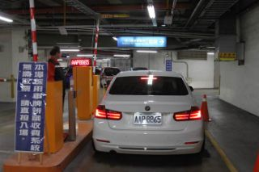
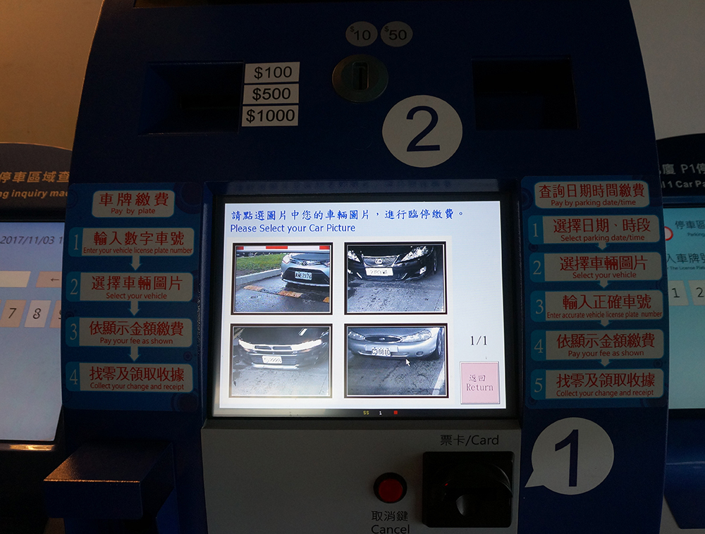
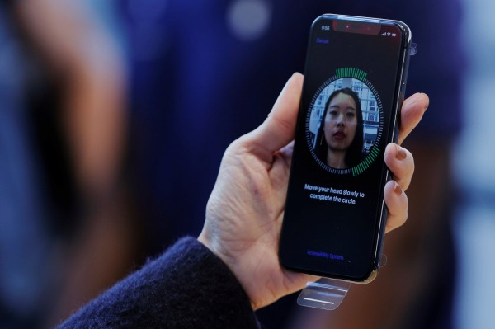
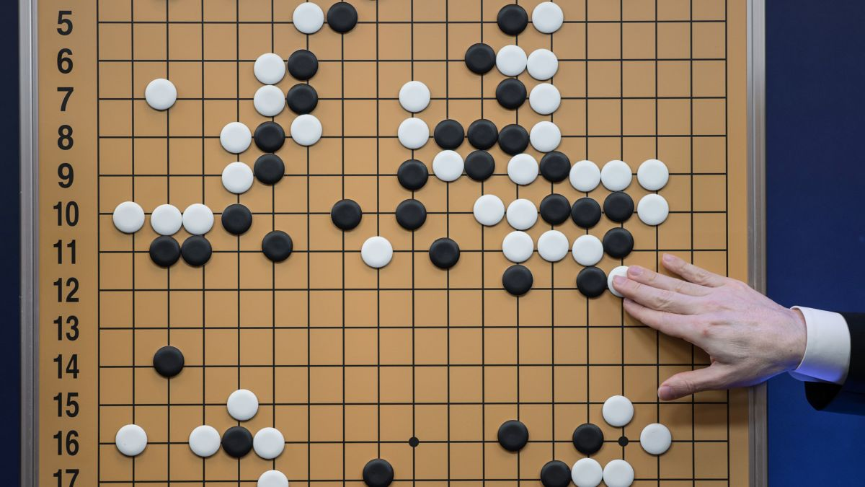
Convolutional Neural Network(CNN)
Some applications of CNN:
Recognition of License Plates
Face ID
Play Go

Slide 3


Digital Images
Digital Image: an image is composed of picture elements(pixels)
Width: 900 pixels
Height: 500 pixels
Total: 900 x 500 = 450000 pixels
900x500
Resolution Specification
Level | Resolution | Quality
SD | 720 x 480 | Low
HD | 1280 x 720 | Medium
Full HD | 1920 x 1080 | High
4K UHD or 4K、4K2K | 3820 x 2160 | Very high
8K UHD or 8K、8K4K | 7640 x 4320 | Next generation
Pixel is the smallest element in an image

Slide 4
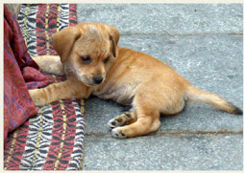
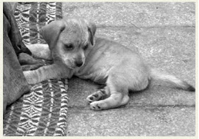


Color v.s. Grayscale Images
Color image
Using RGB three values to represent a pixel
Value range(0~255)
Grayscale image
Using one value to represent the intensity of light
for each pixel (0~255)
R:187
G:132
B:78
R:158
G:175
B:182
value:0
value:200

Slide 5
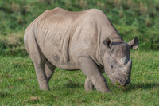
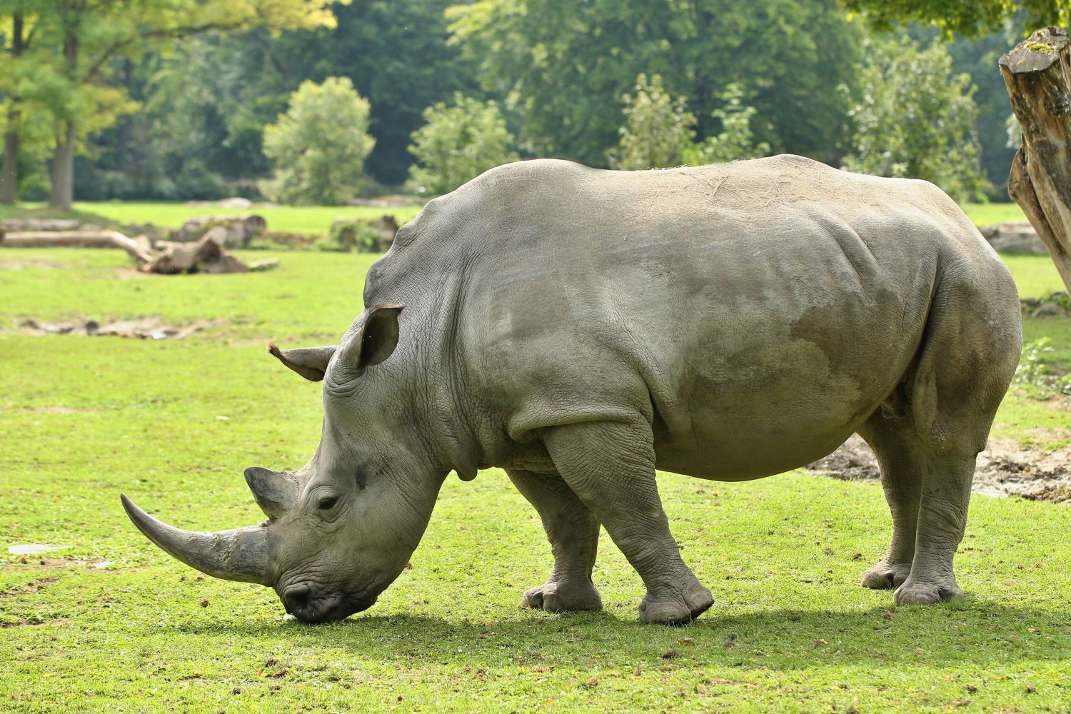
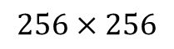
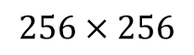
Why CNN Useful for Images
The drawbacks of traditional NN approach for images recognition:
In training phase
x₁
x₂
x₃
Is rhino or not
$$256×256$$
In testing phase
Can it recognize correctly?
…
x₆₅₅₃₆
$$256×256$$

Slide 6
Why CNN Useful for Images
CNN only detects patterns not a whole image:
In the right side
Detected by the same filter
The horn is an important pattern to recognize a rhino image
In the left side

Slide 7
Why CNN Useful for Images
CNN also can detect sub-scale images
rhino
rhino
scaling
Solved by
pooling process

Slide 8
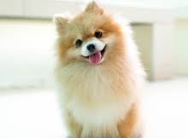
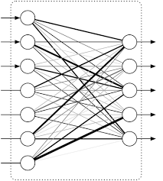
Convolutional Neural Network(CNN)
What kind of the animal?
Fully connected layer
Convolution
Can Repeat many times
Max Pooling
Flatten

Slide 9
Convolutional Neural Network(CNN)
What kind of the animal?
Fully connected layer
Convolution
Can Repeat many times
Max Pooling
Flatten

Slide 10
CNN-Convolution
A filter is a tool for detecting patterns
0
0
0
0
0
1
1
-1
-1
-1
1
1
1
0
1
0
1
1
1
Filter 1
0
0
0
1
0
0
-1
-1
-1
Those elements in filters(kernel) can get by the learning process
0
0
0
0
1
0
1
-1
-1
0
1
1
1
0
0
-1
1
-1
Filter 2
0
0
0
0
0
0
-1
-1
1
6 X 6 image
…
Each filter detects a small pattern (3 X 3)

Slide 11
CNN-Convolution
-1
-1
-1
stride=1
1
1
1
Filter 1
0
0
0
0
0
1
1
-1
-1
-1
x-1
x-1
x-1
1
1
1
0
1
0
x1
x1
x1
0
0
0
1
0
0
x-1
x-1
x-1
3
1
1
-1
0
0
0
0
1
0
0 x (-1) + 0 x (-1) + 0 x (-1) +
1 x 1 + 1 x 1 + 1 x 1 +
0 x (-1) + 0 x (-1) + 0 x (-1) = 3
0
1
1
1
0
0
0
0
0
0
0
0
6 X 6 image

Slide 12
CNN-Convolution
-1
-1
-1
stride=1
1
1
1
Filter 1
0
0
0
0
0
1
1
-1
-1
-1
1
1
1
0
1
0
x-1
x-1
x-1
0
0
0
1
0
0
x1
x1
x1
3
1
1
-1
0
0
0
0
1
0
x-1
x-1
x-1
0
1
1
1
0
0
-3
-1
-2
-1
0
0
0
0
0
0
6 X 6 image

Slide 13
CNN-Convolution
-1
-1
-1
stride=1
1
1
1
Filter 1
0
0
0
0
0
1
1
-1
-1
-1
1
1
1
0
1
0
0
0
0
1
0
0
3
1
1
-1
0
0
0
0
1
0
x-1
x-1
x-1
0
1
1
1
0
0
-3
-1
-2
-1
x1
x1
x1
Feature Map
0
0
0
0
0
0
-2
-4
-2
-1
x-1
x-1
x-1
6 X 6 image
2
3
0
0
4 X 4 image

Slide 14
CNN-Convolution
-1
-1
-1
stride=1
1
1
1
Filter 1
0
0
0
0
0
1
1
-1
-1
-1
1
1
1
0
1
0
0
0
0
1
0
0
3
1
1
-1
0
0
0
0
1
0
x-1
x-1
x-1
0
1
1
1
0
0
-3
-1
-2
-1
Can detect horizontal line
x1
x1
x1
0
0
0
0
0
0
-2
-4
-2
-1
x-1
x-1
x-1
6 X 6 image
2
3
0
0
4 X 4 image

Slide 15
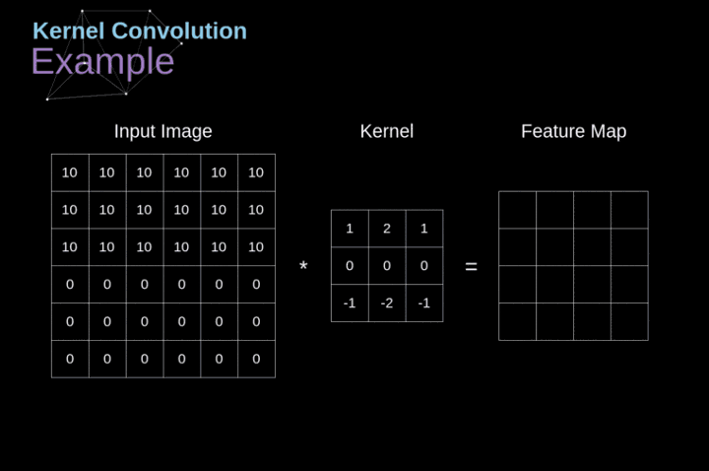
CNN-Convolution

Slide 16
CNN-Convolution
1
-1
-1
stride=1
-1
1
-1
Filter 2
0
0
0
0
0
1
1
-1
-1
1
1
1
1
0
1
0
Generate second feature map by filter2
0
0
0
1
0
0
3
1
1
-1
-2
1
-3
-1
0
0
0
0
1
0
x1
x-1
x-1
-3
-1
-2
-1
0
1
1
1
0
0
-1
-1
2
-3
x-1
x1
x-1
0
0
0
0
0
0
-2
-4
-2
-1
x-1
x-1
x1
0
1
-4
1
6 X 6 image
2
3
0
0
0
-1
-1
-2

Slide 17
CNN-Convolution
-1
-1
-1
stride=2
1
1
1
Filter 1
0
0
0
0
0
1
1
-1
-1
-1
x-1
x-1
x-1
1
1
1
0
1
0
x1
x1
x1
0
0
0
1
0
0
x-1
x-1
x-1
3
1
0
0
0
0
1
0
0
1
1
1
0
0
0
0
0
0
0
0
6 X 6 image

Slide 18
CNN-Convolution
-1
-1
-1
stride=2
1
1
1
Filter 1
0
0
0
0
0
1
1
-1
-1
-1
1
1
1
0
1
0
0
0
0
1
0
0
x-1
x-1
x-1
3
1
0
0
0
0
1
0
x1
x1
x1
-2
-2
0
1
1
1
0
0
x-1
x-1
x-1
0
0
0
0
0
0
Increasing stride will decrease the amount of information, but speed up the computation
6 X 6 image

Slide 19
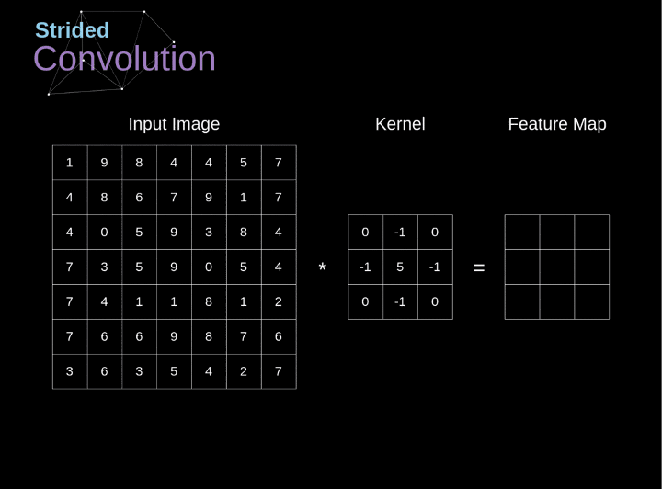
CNN-Convolution
= 2

Slide 20
CNN-Convolution
Zero padding
0
0
0
0
0
0
0
0
Keep the same image size
0
0
0
0
0
1
-2
-3
-2
-2
0
0
0
1
0
1
1
1
0
1
0
0
2
3
1
1
-1
0
0
-1
-1
-1
0
0
0
0
1
0
0
-2
-3
-1
-2
-1
-2
0
1
1
1
*
-1
-2
-4
-2
-1
1
0
0
0
0
0
1
0
0
-1
-1
-1
0
1
1
1
0
0
0
1
2
3
1
0
-1
0
0
0
0
0
0
0
-1
-2
-3
-2
-1
0
0
0
0
0
0
0
0
0
0
0
6 X 6 image

Slide 21
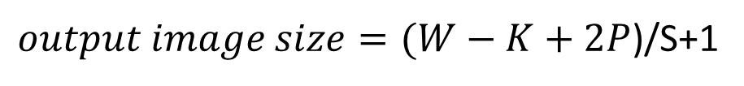
Calculation of Image Size
Example:
$output image size=(W−K+2P$)/S+1
stride=2
0
0
0
0
0
1
W: the input size
K: the Kernel size
P: the padding(1 if padding, else 0)
S: the stride
1
1
1
1
0
1
0
-1
-1
-1
0
0
0
1
0
0
*
1
1
1
0
0
0
0
1
0
-1
-1
-1
0
1
1
1
0
0
0
0
0
0
0
0
Output image size = (6-3)/2 +1 = 2
6 X 6 image

Slide 22
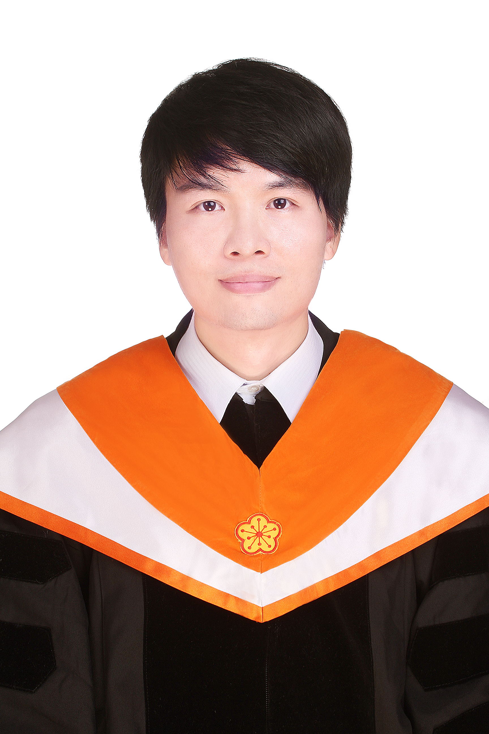
CNN-Convolution
RGB
3 colors (3 channels)
3x3 filter
Height: 254 units(pixels)
Can a filter generate 3 feature maps? NO
256 x 256 x 3
Width: 254 units(pixels)
254 x 254 x 3 RGB Image

Slide 23

Convolution Operation on a Input matrix with a 3x3x3 Kernel
Each filter can generate only one feature map

Slide 24
Convolutional Neural Network(CNN)
What kind of the animal?
Fully connected layer
Convolution
Can Repeat many times
Max Pooling
Flatten

Slide 25
CNN-Max Pooling(Subsampling)
Max Pooling
Average Pooling
Get maximum value for each block
Get mean value for each block
3
1
1
-1
3
1
1
-1
3
1
0
-3/4
-3
-1
-2
-1
-3
-1
-2
-1
-2
-4
-2
-1
-2
-4
-2
-1
3
0
-1/4
-3/4
2
3
0
0
2
3
0
0
Can detect sub-scale images

Slide 26
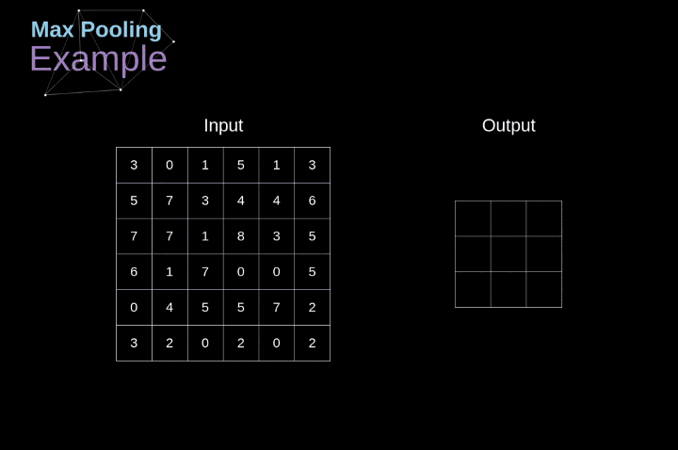
CNN-Max Pooling(Subsampling)

Slide 27
CNN-Max Pooling(Subsampling)
-1
-1
-1
0
0
0
0
0
1
1
-1
-1
1
1
1
1
Filter 2
1
1
1
0
1
0
-1
1
-1
Filter 1
3
1
1
-1
-2
1
-3
-1
-1
-1
-1
0
0
0
1
0
0
-1
-1
1
-3
-1
-2
-1
-1
-1
2
-3
0
0
0
0
1
0
Convolution
-2
-4
-2
-1
0
1
1
1
0
0
0
1
-4
1
0
0
0
0
0
0
2
3
0
0
0
-1
-1
-2
Each filter output a feature map
N filters generate N feature maps
4 x 4 image
3
1
1
2
Max Pooling
3
0
1
1
2 x 2 image

Slide 28
Convolutional Neural Network(CNN)
What kind of the animal?
Fully connected layer
Convolution
Can Repeat many times
Max Pooling
Flatten

Slide 29
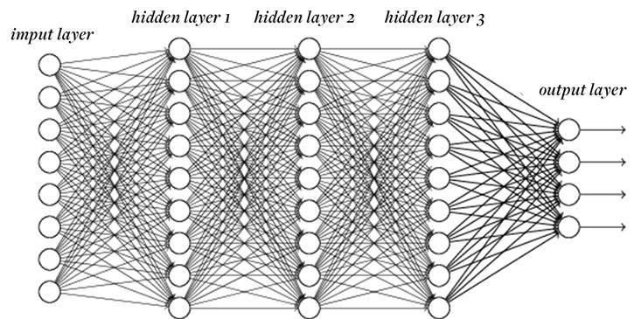
CNN-Flatten
3
1
3
3
1
1
2
0
3
0
1
1
1
2
Fully connected layer
1
1

Slide 30
Convolutional Neural Network(CNN)
Input
Convolution
Pooling
Flatten
Feature Extraction
Classification

Slide 31
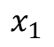
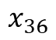
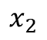
Convolution v.s. Fully Connected
Weights are updated by gradient descent and backpropagation
$$x_{1}$$
0
0
0
0
0
1
1
$$x_{2}$$
1
1
1
0
1
0
Fully connected
…
…
0
0
0
1
0
0
$$x_{36}$$
0
0
0
0
1
0
Convolution
0
1
1
1
0
0
3
1
1
-1
-2
1
-3
-1
0
0
0
0
0
0
-1
-1
-1
1
-1
-1
-3
-1
-2
-1
-1
-1
2
-3
1
1
1
-1
1
-1
-2
-4
-2
-1
0
1
-4
1
-1
-1
-1
-1
-1
1
2
3
0
0
0
-1
-1
-2
How to train and update weights?

Slide 32
Convolution v.s. Fully Connected
-1
-1
-1
1:
0
3
1
1
-1
2:
0
1
1
1
3:
0
-1
-1
-1
3
-3
-1
-2
-1
…
0
0
0
0
0
1
7:
1
1
-2
-4
-2
-1
1
1
1
0
1
0
8:
1
2
3
0
0
0
0
0
1
0
0
9:
1
0
0
0
0
1
0
…
13:
0
0
1
1
1
0
0
14:
0
0
0
0
0
0
0
15:
Only connect to 9 input, not fully connected
0

Slide 33
Convolution v.s. Fully Connected
-1
-1
-1
1:
0
2:
Hidden layer with 16 nodes
3
1
1
-1
0
1
1
1
3:
0
-1
-1
-1
3
-3
-1
-2
-1
4:
0
…
0
0
0
0
0
1
7:
1
1
-2
-4
-2
-1
1
1
1
1
0
1
0
8:
1
2
3
0
0
…
0
0
0
1
0
0
9:
1
10:
0
0
0
0
0
1
0
…
13:
0
0
1
1
1
0
0
14:
0
0
0
0
0
0
0
15:
0
Shared weights
16:
1

Slide 34
CNN-Keras Example
Step 1:
# Import Keras libraries and packages
from keras.models import Sequential # Start a NN
from keras.layers import Conv2D # Convolution Operation
from keras.layers import MaxPooling2D # Pooling
from keras.layers import Flatten
from keras.layers import Dense # Fully Connected Networks
Input are 128 x 128 RGB images
There are 32 3x3 filters
Step 2:
# initializing CNN
model = Sequential()
model.add(Conv2D(32, 3, 3, input_shape = (128, 128, 3), activation = 'relu’))
model.add(MaxPooling2D(pool_size = (2, 2)))
The block size of max pooling is 2x2
1:white, 3:RGB

Slide 35
CNN-Keras Example
Step 3:
# Second convolutional layer
model.add(Conv2D(32, 3, 3, activation = 'relu')) model.add(MaxPooling2D(pool_size = (2, 2)))
Step 4:
# Flatten feature maps
model.add(Flatten())
If the total class number is 10
Step 5:
# Add fully connected layer
model.add(Dense(128, activation = 'relu’))
model.add(Dense(10, activation='softmax'))

Slide 36
Evolution of CNN Architectures
CNN started to get attention

Slide 37
Evolution of CNN Architectures
ILSVR: ImageNet Large Scale Visual Recognition Challenge
16.4
Error rate less than human’s recognition
7.3
6.7
8 layers
19 layers
22 layers
3.57
152 layers
ILSVRC’12
AlexNet
ILSVRC’14
VGG
ILSVRC’14
GoogleNet
ILSVRC’15
ResNet

Slide 38
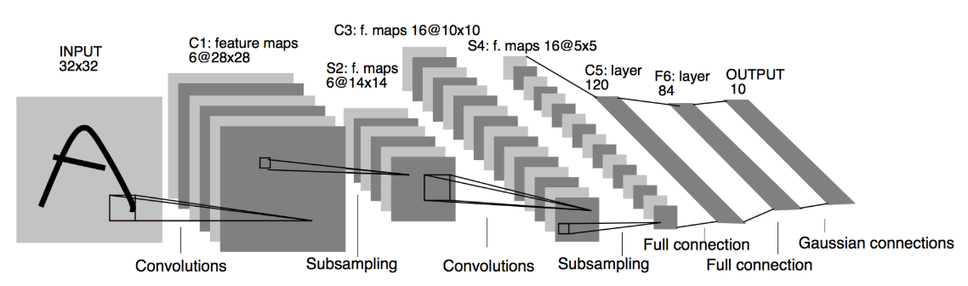
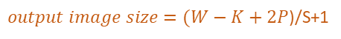
Classic CNN Architectures
$output image size=(W−K+2P$)/S+1
LeNet-5 Architecture, 1998
W: the input size
K: the Kernel size
P: the padding
(1 if padding, else 0)
S: the stride
# initialize the model
model = Sequential()
# first layer, convolution and pooling
model.add(Conv2D(input_shape=(32, 32, 1), kernel_size=(5, 5), filters=6, strides=(1,1), activation='tanh'))
model.add(AveragePooling2D(pool_size=(2, 2), strides=(2, 2)))
# second layer, convolution and pooling
model.add(Conv2D(kernel_size=(5, 5), filters=16, strides=(1,1), activation='tanh'))
model.add(AveragePooling2D(pool_size=(2, 2), strides=(2, 2)))
(horizontal, vertical)
2x2
2x2
2x2
2x2

Slide 39
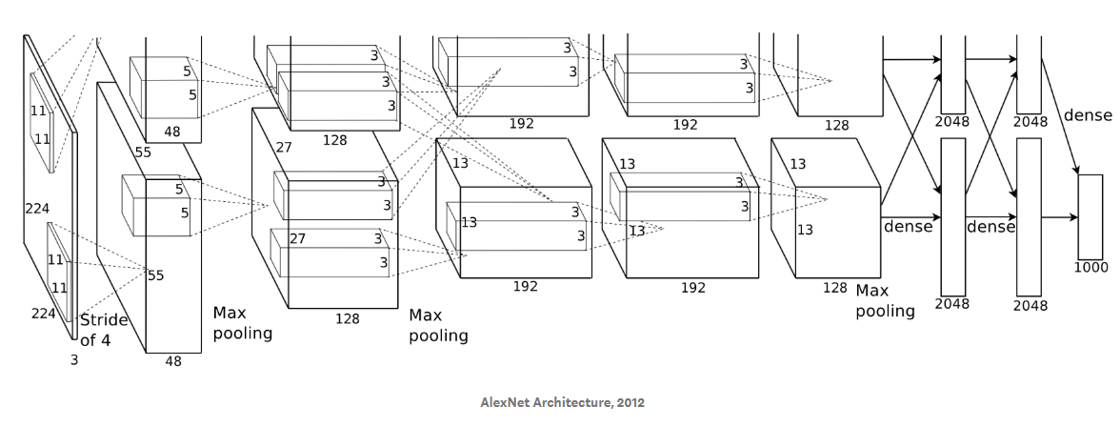
Classic CNN Architectures
Use ReLU and Dropout
AlexNet-5 Architecture, 2012
The architecture was divided into two parts because of memory limitation at that time
# initialize the model
model = Sequential()
#First Convolution and Pooling layer
model.add(Conv2D(96,(11,11),strides=(4,4),input_shape=(224,224,3),padding='valid',activation='relu'))
model.add(MaxPooling2D(pool_size=(3,3),strides=(2,2)))
#Second Convolution and Pooling layer
model.add(Conv2D(256,(5,5),strides=(1,1),padding='same',activation='relu'))
model.add(MaxPooling2D(pool_size=(3,3),strides=(2,2)))
#Three Convolution layer and Pooling Layer
model.add(Conv2D(384,(3,3),strides=(1,1),padding='same',activation='relu'))
model.add(Conv2D(384,(3,3),strides=(1,1),padding='same',activation='relu'))
model.add(Conv2D(256,(3,3),strides=(1,1),padding='same',activation='relu'))
model.add(MaxPooling2D(pool_size=(3,3),strides=(2,2)))

Slide 40
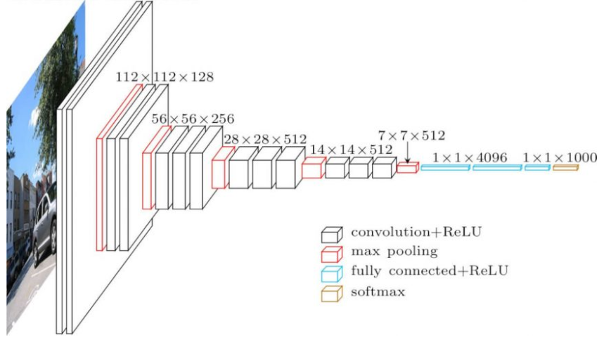
Classic CNN Architectures
VGG16 Architecture
# initialize the model
model = Sequential()
# VGG16
model.add(Conv2D(64,(3,3),strides=(1,1),input_shape=(224,224,3),padding='same',activation='relu'))
model.add(Conv2D(64,(3,3),strides=(1,1),padding='same',activation='relu'))
model.add(MaxPooling2D(pool_size=(2,2)))
model.add(Conv2D(128,(3,2),strides=(1,1),padding='same',activation='relu'))
model.add(Conv2D(128,(3,3),strides=(1,1),padding='same',activation='relu'))
model.add(MaxPooling2D(pool_size=(2,2)))
model.add(Conv2D(256,(3,3),strides=(1,1),padding='same',activation='relu'))
model.add(Conv2D(256,(3,3),strides=(1,1),padding='same',activation='relu'))
model.add(Conv2D(256,(3,3),strides=(1,1),padding='same',activation='relu'))
model.add(MaxPooling2D(pool_size=(2,2)))
model.add(Conv2D(512,(3,3),strides=(1,1),padding='same',activation='relu'))
model.add(Conv2D(512,(3,3),strides=(1,1),padding='same',activation='relu'))
model.add(Conv2D(512,(3,3),strides=(1,1),padding='same',activation='relu'))
model.add(MaxPooling2D(pool_size=(2,2)))
model.add(Conv2D(512,(3,3),strides=(1,1),padding='same',activation='relu'))
model.add(Conv2D(512,(3,3),strides=(1,1),padding='same',activation='relu'))
model.add(Conv2D(512,(3,3),strides=(1,1),padding='same',activation='relu'))
model.add(MaxPooling2D(pool_size=(2,2)))

Slide 41
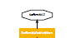
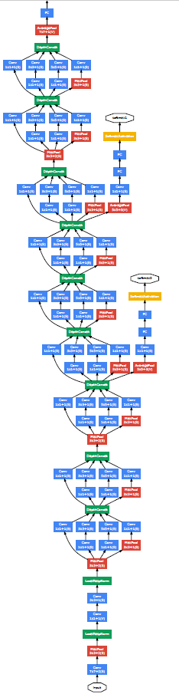
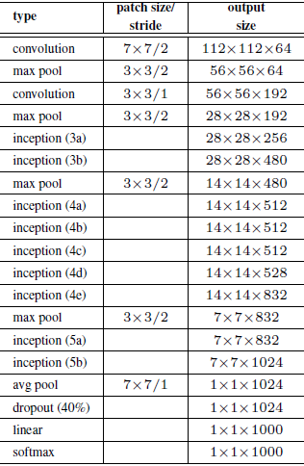
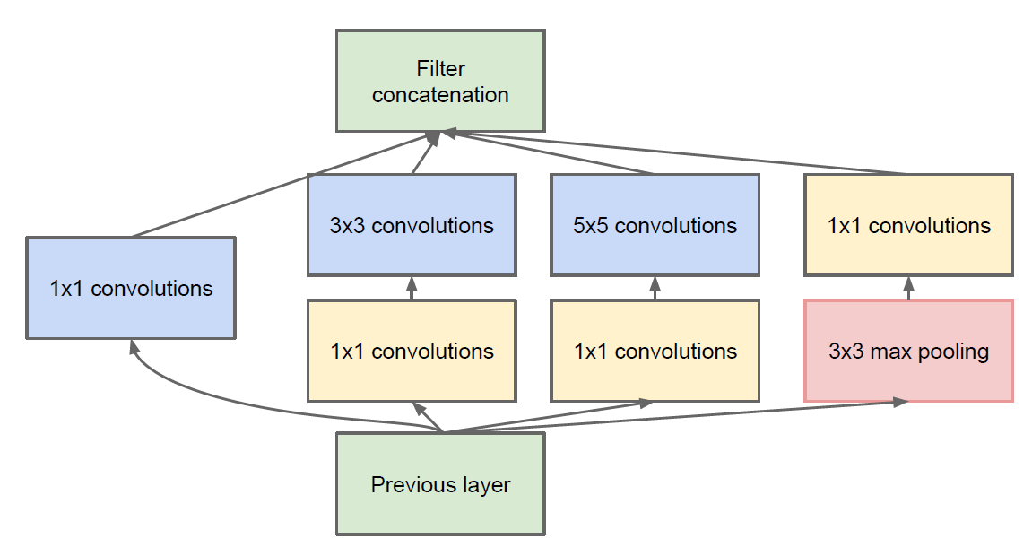
Classic CNN Architectures
Google net
Inception
Github code:
https://gist.github.com/joelouismarino/a2ede9ab3928f999575423b9887abd14

Slide 42
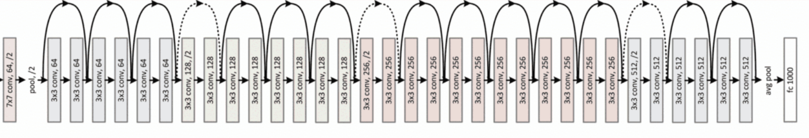
Classic CNN Architectures
34-layer residual
Image
Residual Network
https://arxiv.org/abs/1512.03385
https://github.com/broadinstitute/keras-resnet

Slide 43
Practice Time
MNIST Example
https://github.com/KPY1234/NTHUCE_DeepLearning2/blob/master/MNIST/mnist_cnn.ipynb

Slide 44
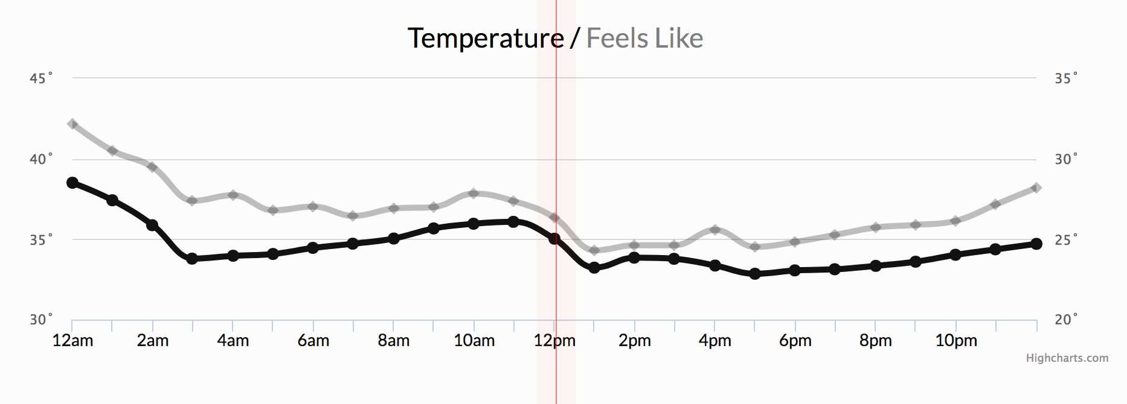
Recurrent Neural Network (RNN)
For time series data:
A time series is a series of data points indexed in time order.
EX:

Slide 45

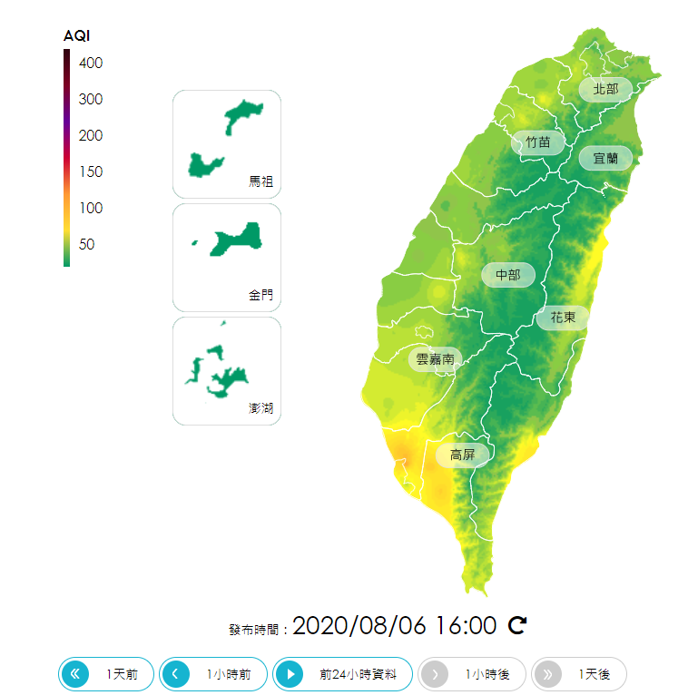

Recurrent Neural Network (RNN)
Some RNN use cases:

Slide 46
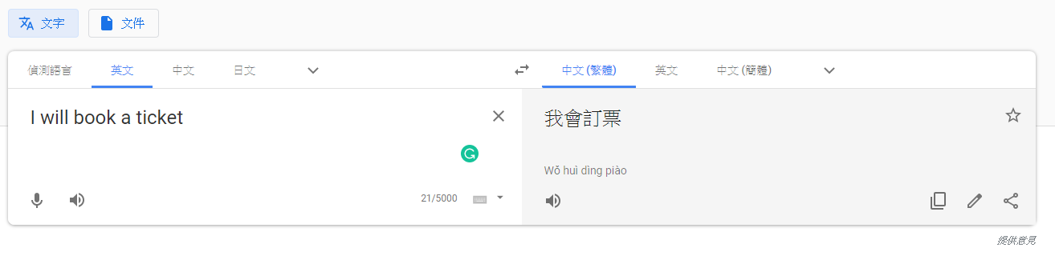
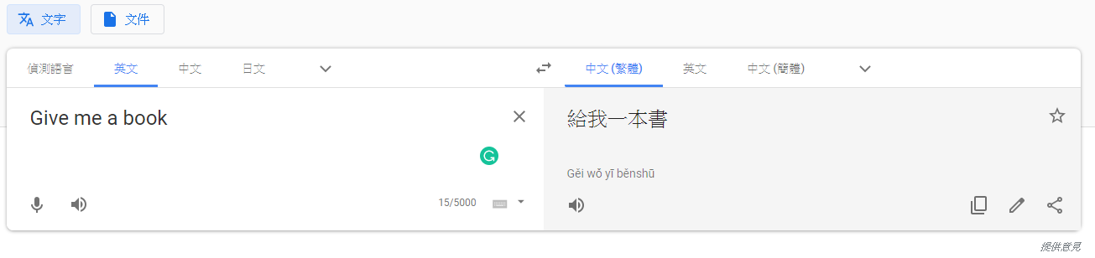
Recurrent Neural Network (RNN)
Common RNN application:
Google Translator
The same word but different meaning

Slide 47
Recurrent Neural Network (RNN)
Example: Use fully connected neural network to determine the part of speech(PoS)
noun?
I
will
book
a
ticket
PoS:
subject
auxiliary
verb
article
noun
Neural Network
Problem?
Give
me
a
book
word vector
book
PoS:
verb
object
article
noun

Slide 48
Recurrent Neural Network (RNN)
Example: Use fully connected neural network to determine the part of speech(PoS)
noun?
I
will
book
a
ticket
PoS:
subject
auxiliary
verb
article
noun
Neural Network
Problem?
Give
me
a
book
word vector
book
PoS:
verb
object
article
noun

Slide 49
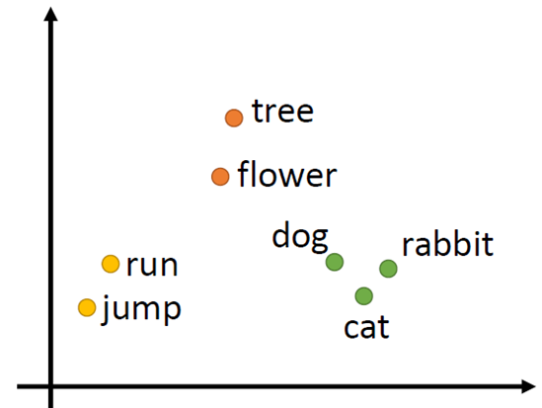
Word Vector
The process of projecting the word to a vector is also called word embedding
Every word is represented as a vector

Slide 50
Word Vector
The simplest way is 1-of-N encoding:
lexicon = {I, will, book, a, ticket, Give, me}:
1-of-N Encoding
I = [1 0 0 0 0 0 0]
The dimension for the word is 1, and others are 0
will = [0 1 0 0 0 0 0]
How about chemical element ?
book = [0 0 1 0 0 0 0]
a = [0 0 0 1 0 0 0]
ticket = [0 0 0 0 1 0 0]
Give = [0 0 0 0 0 1 0]
me = [0 0 0 0 0 0 1]

Slide 51
Keras-Word Vector
Keras tokenizer example:
keras.preprocessing.text import Tokenizer
text = ["I will book a ticket", "Give me a book"]
# transform word sequences into index sequences tokenizer.fit_on_texts(text)
tokenizer.texts_to_sequences(text)
https://github.com/KPY1234/NTHUCE_DeepLearning2/blob/master/ProteinSequenceClassification/src/TokenizerExample.ipynb
Keras embedding layer example:
from keras.models import Sequential
from keras.layers.embeddings import Embedding
# initialize the model
model = Sequential()
# add Keras embedding layer to transform a word into a vector
model.add(Embedding(vocab_size, output_dim=8, input_length=max_length))
https://github.com/KPY1234/NTHUCE_DeepLearning2/blob/master/ProteinSequenceClassification/src/EmbeddingExample.ipynb

Slide 52
Recurrent Neural Network (RNN)
Example: Use fully connected neural network to determine the part of speech(PoS)
noun?
I
will
book
a
ticket
PoS:
subject
auxiliary
verb
article
noun
Neural Network
Same features can output different result?
Problem?
Neural network needs memory
Give
me
a
book
0
0
1
0
0
0
0
book
PoS:
verb
object
article
noun

Slide 53
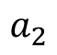
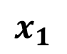
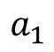
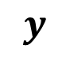
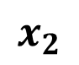
Recurrent Neural Network (RNN)
$$y$$
The output of hidden layer
are stored in the memory.
store
Memory
$$a_{1}$$
$$a_{2}$$
feed
$$x_{1}$$
$$x_{2}$$
Memory can be considered
as another input.

Slide 54
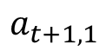
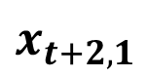
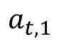
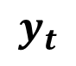
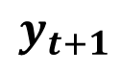
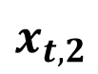
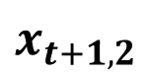
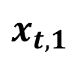
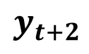
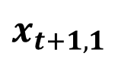



Recurrent Neural Network (RNN)
The same network is used again and again.
$$y_{t}$$
$$y_{t+1}$$
$$y_{t+2}$$
…
$$a_{t,1}$$
$$a_{t,2}$$
$$a_{t+1,1}$$
$$a_{t+1,2}$$
…
$$x_{t,1}$$
$$x_{t,2}$$
$$x_{t+1,1}$$
$$x_{t+1,2}$$
$$x_{t+2,1}$$
$$x_{t+2,2}$$

Slide 55



Recurrent Neural Network (RNN)
Simple example:
Input sequence:
$$\left[\begin{matrix}1 \\ 0\end{matrix}\right]$$
$$\left[\begin{matrix}0 \\ 1\end{matrix}\right]$$
$$\left[\begin{matrix}1 \\ 0\end{matrix}\right]$$
…
$$y_{t}$$
2
$$y_{t+1}$$
4
Output sequence:
2
4
6
$$y_{t+2}$$
6
All the weights are “1”, no bias
All activation functions are linear
Same input but different output
…
$$a_{t,1}$$
$$a_{t,2}$$
1
2
$$a_{t+1,1}$$
$$a_{t+1,2}$$
1
2
…
$$x_{t,1}$$
$$x_{t,2}$$
$$x_{t+1,1}$$
$$x_{t+1,2}$$
$$x_{t+2,1}$$
$$x_{t+2,2}$$
1
0
0
1
1
0

Slide 56










Recurrent Neural Network (RNN)
auxiliary
verb
article
Possible!!
noun
$$y_{t+1}$$
$$y_{t+2}$$
$$y_{t+2}$$
$$y_{t+3}$$
$$a_{t+1}$$
…
$$a_{t+2}$$
…
$$x_{t+1}$$
$$x_{t+2}$$
$$x_{t+2}$$
$$x_{t+3}$$
will
book
a
book

Slide 57








Recurrent Neural Network (RNN)
Deep RNN:
$$y_{t}$$
$$y_{t+1}$$
$$y_{t+2}$$
$$y_{t+3}$$
…
…
…
…
…
$$x_{t}$$
$$x_{t+1}$$
$$x_{t+2}$$
$$x_{t+3}$$

Slide 58









Recurrent Neural Network (RNN)
Bidirectional RNN:
$$x_{t}$$
$$x_{t+1}$$
$$x_{t+2}$$
Consider data before and after the time t+1
When time is t+1
$$y_{t}$$
$$y_{t+1}$$
$$y_{t+2}$$
…
$$x_{t}$$
$$x_{t+1}$$
$$x_{t+2}$$

Slide 59







Recurrent Neural Network (RNN)
The drawback of RNN:
Can't memorize long time information
$$y_{t}$$
$$y_{t+1}$$
memory is overridden every time
Less information
Give
me
a
book
$$a_{t}$$
$$a_{t+1}$$
$$a_{t+2}$$
verb
object
article
noun
$$x_{t}$$
$$x_{t+1}$$
…
Give
me

Slide 60
Long Short-Term Memory(LSTM)
output
4 input
1 output
Signal control the output gate
Output Gate
Memory Cell
Forget Gate
Signal control the forget gate
Signal control the input gate
Input Gate
LSTM
input

Slide 61











Long Short-Term Memory(LSTM)
$$z_{o}$$
Activation function f is usually a sigmoid function
Output Gate
$$c$$
$$c$$
$$f(z_{f})$$
$$z_{f}$$
multiply
$$f\left(z_{i}\right)g(z)$$
Forget Gate
$$f(z_{i})$$
multiply
$$cf(z_{f})$$
$$z_{i}$$
$$g(z)$$
Input Gate
LSTM
$$z$$

Slide 62





Long Short-Term Memory(LSTM)
$$f\left(z_{o}\right)h(c^{′})$$
$$f(z_{o})$$
$$z_{o}$$
multiply
Activation function f is usually a sigmoid function
Output Gate
$$h(c^{′})$$
$$c$$
$$c^{′}=cf\left(z_{f}\right)+f\left(z_{i}\right)g(z)$$
$$c^{′}$$
$$f(z_{f})$$
$$z_{f}$$
multiply
$$f\left(z_{i}\right)g(z)$$
Forget Gate
$$f(z_{i})$$
multiply
$$cf(z_{f})$$
$$z_{i}$$
$$g(z)$$
Input Gate
LSTM
$$z$$

Slide 63





















LSTM-Example
y
$$x_{1}$$
100
y
?
?
?
?
?
$$x_{2}$$
100
+
$$x_{3}$$
100
Output Gate
$$b$$
10
0
$$x_{1}$$
$$σ(z)=\frac{1}{1+e^{−z}}$$
-100
$$x_{2}$$
0
+
$$x_{1}$$
100
0
$$x_{3}$$
Forget Gate
$$x_{2}$$
0
10
$$b$$
+
$$x_{3}$$
100
Input Gate
$$b$$
-10
LSTM
$$x_{1}$$
2
0
2
5
3
$$x_{2}$$
0
1
-2
-3
-1
+
1
1
0
0
$$x_{3}$$
0
0
1
2
-6
$$x_{1}$$
$$x_{2}$$
$$x_{3}$$
$$b$$

Slide 64

















LSTM-Example
y
$$2$$
100
y
?
?
?
?
?
$$0$$
100
+
$$0$$
100
Output Gate
$$1$$
10
0
$$2$$
$$σ(z)=\frac{1}{1+e^{−z}}$$
$$≈1$$
-100
$$0$$
0
+
$$2$$
100
0
$$0$$
Forget Gate
$$0$$
0
2
10
$$1$$
$$≈1$$
+
$$0$$
100
2
Input Gate
$$1$$
-10
LSTM
$$x_{1}$$
2
0
2
5
3
$$x_{2}$$
0
1
-2
-3
-1
+
1
1
0
0
$$x_{3}$$
0
0
1
2
-6
2
$$0$$
$$0$$
$$1$$

Slide 65

LSTM-Example
y
2
$$2$$
100
y
2
$$≈1$$
?
?
?
?
?
$$0$$
100
+
$$0$$
100
Output Gate
2
$$1$$
10
0
$$2$$
$$σ(z)=\frac{1}{1+e^{−z}}$$
$$≈1$$
-100
$$0$$
2
+
$$2$$
100
0
$$0$$
Forget Gate
$$0$$
0
2
10
$$1$$
$$≈1$$
+
$$0$$
100
2
Input Gate
$$1$$
-10
LSTM
$$x_{1}$$
2
0
2
5
3
$$x_{2}$$
0
1
-2
-3
-1
+
1
1
0
0
$$x_{3}$$
0
0
1
2
-6
2
$$0$$
$$0$$
$$1$$

Slide 66









LSTM-Example
y
$$0$$
100
y
2
?
?
?
?
?
$$1$$
100
+
$$0$$
100
Output Gate
$$1$$
10
0
$$0$$
$$σ(z)=\frac{1}{1+e^{−z}}$$
$$≈0$$
-100
$$1$$
2
+
$$0$$
100
0
$$0$$
Forget Gate
$$1$$
0
0
10
$$1$$
$$≈0$$
+
$$0$$
100
1
Input Gate
$$1$$
-10
LSTM
$$x_{1}$$
2
0
2
5
3
$$x_{2}$$
0
1
-2
-3
-1
+
1
1
0
0
$$x_{3}$$
0
0
1
2
-6
0
$$1$$
$$0$$
$$1$$

Slide 67
LSTM-Example
y
0
$$0$$
100
y
2
?
?
?
?
?
$$≈1$$
0
$$1$$
100
+
$$0$$
100
Output Gate
0
$$1$$
10
0
$$0$$
$$σ(z)=\frac{1}{1+e^{−z}}$$
$$≈0$$
-100
$$1$$
0
+
$$0$$
100
0
$$0$$
Forget Gate
$$1$$
0
0
10
$$1$$
$$≈0$$
+
$$0$$
100
1
Input Gate
$$1$$
-10
LSTM
$$x_{1}$$
2
0
2
5
3
$$x_{2}$$
0
1
-2
-3
-1
+
1
1
0
0
$$x_{3}$$
0
0
1
2
-6
0
$$1$$
$$0$$
$$1$$

Slide 68








LSTM-Example
y
$$2$$
100
y
2
?
?
?
?
?
0
$$−2$$
100
+
$$1$$
100
Output Gate
$$1$$
10
0
$$2$$
$$σ(z)=\frac{1}{1+e^{−z}}$$
$$≈1$$
-100
$$−2$$
0
+
$$2$$
100
0
$$1$$
Forget Gate
$$−2$$
0
0
10
$$1$$
$$≈1$$
+
$$1$$
100
0
Input Gate
$$1$$
-10
LSTM
$$x_{1}$$
2
0
2
5
3
$$x_{2}$$
0
1
-2
-3
-1
+
1
1
0
0
$$x_{3}$$
0
0
1
2
-6
2
$$−2$$
$$1$$
$$1$$

Slide 69
LSTM-Example
y
0
$$2$$
100
y
2
0
?
?
?
?
?
$$≈1$$
0
$$−2$$
100
+
$$1$$
100
Output Gate
0
$$1$$
10
0
$$2$$
$$σ(z)=\frac{1}{1+e^{−z}}$$
$$≈1$$
-100
$$−2$$
0
+
$$2$$
100
0
$$1$$
Forget Gate
$$−2$$
0
0
10
$$1$$
$$≈1$$
+
$$1$$
100
0
Input Gate
$$1$$
-10
LSTM
$$x_{1}$$
2
0
2
5
3
$$x_{2}$$
0
1
-2
-3
-1
+
1
1
0
0
$$x_{3}$$
0
0
1
2
-6
2
$$−2$$
$$1$$
$$1$$

Slide 70












LSTM-Example
y
$$5$$
100
y
2
0
?
?
?
?
?
0
$$−3$$
100
+
$$2$$
100
Output Gate
$$1$$
10
0
$$5$$
$$σ(z)=\frac{1}{1+e^{−z}}$$
$$≈1$$
-100
$$−3$$
0
+
$$5$$
100
0
$$2$$
Forget Gate
$$−3$$
0
2
10
$$1$$
$$≈1$$
+
$$2$$
100
2
Input Gate
$$1$$
-10
LSTM
$$x_{1}$$
2
0
2
5
3
$$x_{2}$$
0
1
-2
-3
-1
+
1
1
0
0
$$x_{3}$$
0
0
1
2
-6
$$5$$
$$−3$$
$$2$$
$$1$$

Slide 71

LSTM-Example
y
2
$$5$$
100
y
2
2
?
?
?
?
?
$$≈1$$
0
0
$$−3$$
100
+
$$2$$
100
Output Gate
2
$$1$$
10
0
$$5$$
$$σ(z)=\frac{1}{1+e^{−z}}$$
$$≈1$$
-100
$$−3$$
2
+
$$5$$
100
0
$$2$$
Forget Gate
$$−3$$
0
2
10
$$1$$
$$≈1$$
+
$$2$$
100
2
Input Gate
$$1$$
-10
LSTM
$$x_{1}$$
2
0
2
5
3
$$x_{2}$$
0
1
-2
-3
-1
+
1
1
0
0
$$x_{3}$$
0
0
1
2
-6
$$5$$
$$−3$$
$$2$$
$$1$$

Slide 72












LSTM-Example
y
$$3$$
100
y
2
0
2
?
?
?
?
?
0
$$−1$$
100
+
$$−6$$
100
Output Gate
$$1$$
10
0
$$3$$
$$σ(z)=\frac{1}{1+e^{−z}}$$
$$≈1$$
-100
$$−1$$
2
+
$$3$$
100
0
$$−6$$
Forget Gate
$$−1$$
0
0
10
$$1$$
$$≈0$$
+
$$−6$$
100
2
Input Gate
$$1$$
-10
LSTM
$$x_{1}$$
2
0
2
5
3
$$x_{2}$$
0
1
-2
-3
-1
+
1
1
0
0
$$x_{3}$$
0
0
1
2
-6
$$3$$
$$−1$$
$$−6$$
$$1$$

Slide 73


LSTM-Example
y
0
$$3$$
100
y
2
2
?
?
?
?
?
$$≈0$$
0
0
0
$$−1$$
100
+
$$−6$$
100
Output Gate
2
$$1$$
10
0
$$3$$
$$σ(z)=\frac{1}{1+e^{−z}}$$
$$≈1$$
-100
$$−1$$
2
+
$$3$$
100
0
$$−6$$
Forget Gate
$$−1$$
0
0
10
$$1$$
$$≈0$$
+
$$−6$$
100
2
Input Gate
$$1$$
-10
LSTM
$$x_{1}$$
2
0
2
5
3
$$x_{2}$$
0
1
-2
-3
-1
+
1
1
0
0
$$x_{3}$$
0
0
1
2
-6
$$3$$
$$−1$$
$$−6$$
$$1$$

Slide 74





LSTM-Example
y
$$z_{o}=xw_{o}$$
$w,w_{i},w_{f},w_{o}$ are needed to be trained
Output Gate
4 times of parameters
Memory
$$z_{f}=xw_{f}$$
Forget Gate
$$z_{i}=xw_{i}$$
Input Gate
LSTM
Input
$$z=xw$$

Slide 75

LSTM Final Structure
y^{t}
y^{t+1}
c^{t-1}
c^{t}
c^{t+1}
$$×$$
$$＋$$
$$×$$
$$×$$
$$＋$$
$$×$$
$$×$$
$$×$$
z^{f}
z^{i}
z
zº
z^{f}
z^{i}
z
zº
h^{t-1}
x^{t}
h^{t}
x^{t+1}

Slide 76





















LSTM Final Structure
$$y^{t}$$
$$z=(W∗[h^{t−1},x^{t}])$$
$$y^{t}=σ(W^{′}{∗h}^{t}\text{)}$$
…
$$z^{i}={σ(W}_{i}∗[h^{t−1},x^{t}])$$
…
$$z^{f}={σ(W}_{f}∗[h^{t−1},x^{t}])$$
y^{t}
$$c^{t}=z^{f}×c^{t−1}+z^{i}×z$$
$$z^{o}$$
$$h^{t}$$
multiply
c^{t-1}
c^{t}
$$[h^{t−1},x^{t}]$$
Output Gate
tanh
$$×$$
$$＋$$
$$×$$
$$c^{t−1}$$
$$c^{t}$$
$$z^{f}$$
$$×$$
multiply
$$[h^{t−1},x^{t}]$$
Forget Gate
$$z^{o}={σ(W}_{o}∗[h^{t−1},x^{t}])$$
$$z_{i}∙z$$
multiply
$$c∙z_{f}$$
$$z^{i}$$
z^{f}
z^{i}
z
zº
$$[h^{t−1},x^{t}]$$
Input Gate
$$z$$
LSTM
$$h^{t}=z^{o}×{tanh⁡(c}^{t})$$
concatenate
h^{t}
h^{t-1}
x^{t}
$$[h^{t−1},x^{t}]$$

Slide 77








LSTM Final Structure
Feed forward to next timestep
y^{t}
c^{t}
$$z^{i}={σ(W}_{i}∗[h^{t−1},x^{t}])$$
c^{t-1}
$$z^{f}={σ(W}_{f}∗[h^{t−1},x^{t}])$$
$$×$$
$$＋$$
$$×$$
$$z=(W∗[h^{t−1},x^{t}])$$
$$z^{o}={σ(W}_{o}∗[h^{t−1},x^{t}])$$
…
$$×$$
…
$$c^{t}=z^{f}×c^{t−1}+z^{i}×z$$
z^{f}
z^{i}
z
zº
$$h^{t}=z^{o}×{tanh⁡(c}^{t})$$
$y^{t}=σ(W^{′}{∗h}^{t}$)
concatenate
h^{t-1}
x^{t}
h^{t}

Slide 78














GRU(Gated Recurrent Unit)
$$y^{t}$$
$$h^{t−1}$$
GRU
$$h^{t}$$
y^{t}
$$x^{t}$$
h^{t-1}
$$×$$
$$＋$$
h^{t}
1-
$$z=(W∗[h^{t−1},x^{t}])$$
$$×$$
$$×$$
…
$$r={σ(W}_{r}∗[h^{t−1},x^{t}])$$
…
reset
update
$$h^{′}=tanh⁡(W∗[r×h^{t−1},x^{t}])$$
r
z
$$h^{′}$$
$$h^{t}=z×h^{t−1}+(1−z)×h^{′}$$
concatenate
concatenate
$$y^{t}=σ(W^{′}{∗h}^{t}\text{)}$$
h^{t-1}
x^{t}
x^{t}

Slide 79








LSTM v.s. GRU
LSTM
GRU
$$c^{t}=z^{f}×c^{t−1}+z^{i}×z$$
$$h^{t}=z×h^{t−1}+(1−z)×h^{′}$$
y^{t}
y^{t}
c^{t-1}
c^{t}
h^{t-1}
$$×$$
$$＋$$
h^{t}
$$×$$
$$＋$$
$$×$$
$$×$$
1-
$$×$$
…
$$×$$
…
…
…
reset
update
z^{f}
z^{i}
z
zº
r
z
$$h^{′}$$
concatenate
concatenate
concatenate
h^{t-1}
x^{t}
h^{t}
h^{t-1}
x^{t}
x^{t}

Slide 80





Many to One
Input is a vector sequence, but output is only one vector
$$y_{t+3}$$
$$x_{t}$$
$$x_{t+1}$$
$$x_{t+2}$$
$$x_{t+3}$$

Slide 81




Many to One
Example:
Determine whether a sentence is positive, neutral, or negative
negative
neutral
positive
$$I$$
$$love$$
$$\text{chemical}$$
$$\text{engineering}$$

Slide 82



Many to Many
Input is a vector sequence and output is also a vector sequence
$$y_{t}$$
$$y_{t+1}$$
$$y_{t+2}$$
$$y_{t+3}$$
$$x_{t}$$
$$x_{t+1}$$
$$x_{t+2}$$
$$x_{t+3}$$

Slide 83





Many to Many
Example: Speech to text
$$\text{artificial}$$
$$\text{intelligence}$$
$$\text{is}$$
$$\text{fun}$$

Slide 84
Keras Example
for RNN
units: Positive integer, dimensionality of the output space
timesteps
many to one
model = Sequential() model.add(SimpleRNN(5, input_shape=(6, 10), return_sequences=False)) model.add(Dense(3)) model.add(Dense(1)) model.compile(loss="mse", optimizer="adam")
feature dimension
for LSTM
units: Positive integer, dimensionality of the output space
timesteps
many to many
model = Sequential() model.add(LSTM(5, input_shape=(6, 10), return_sequences=True)) model.add(Dense(3)) model.add(Dense(1)) model.compile(loss="mse", optimizer="adam")
feature dimension

Slide 85
Keras Example
for GRU
units: Positive integer, dimensionality of the output space
timesteps
many to one
model = Sequential() model.add(GRU (5, input_shape=(6, 10), return_sequences=False)) model.add(Dense(3)) model.add(Dense(1)) model.compile(loss="mse", optimizer="adam")
feature dimension

Slide 86
Practice Time
Protein Sequence Classification
https://github.com/KPY1234/NTHUCE_DeepLearning2/tree/master/ProteinSequenceClassification

Slide 87

Thank you for your attention

